Slide 1


Cloud for AI
End to End MLOps Example
Filotas Theodosiou

Slide 2
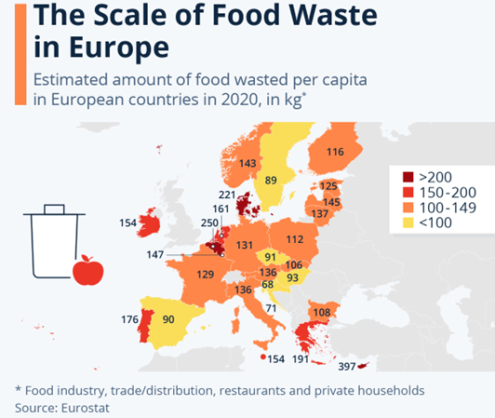
Food Waste: The Situation.
•Flanders has wasted almost 900.000 tones of food in 2020
•That’s enough to feed 800.000 people/year
•Food waste accounts for 8% of Belgium greenhouse emissions

Slide 3
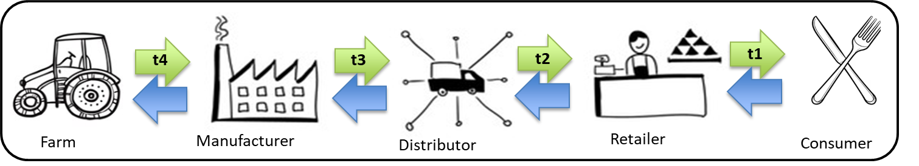
What is the Case?
•Total time from the Farm to The Consumer: T = t1 + t2 + t3 + t4
•Is the Consumer willing to wait T for his meal? No!
•So we need Inventory!

Slide 4
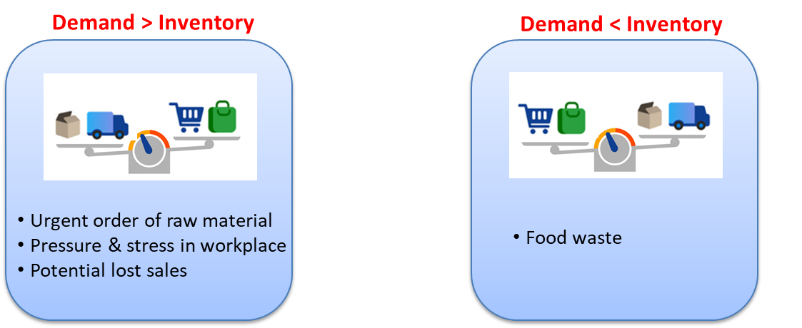
How Much Inventory?

Slide 5
How to Solve the Problem!

Slide 6
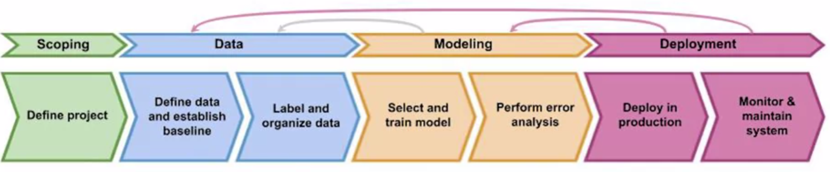
Structuring the Problem.

Slide 7
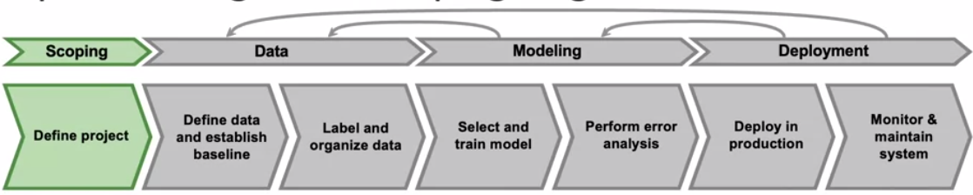
Structuring the Problem.
Identify the problem
Brainstorm solutions
Assess the feasibility of the solutions
Conclude on strategy
Determine milestones
Set budget, timelines etc

Slide 8
Structuring the Problem.
Identify the problem
Brainstorm solutions
Assess the feasibility of the solutions
Conclude on strategy
Determine milestones
Set budget, timelines etc

Slide 9
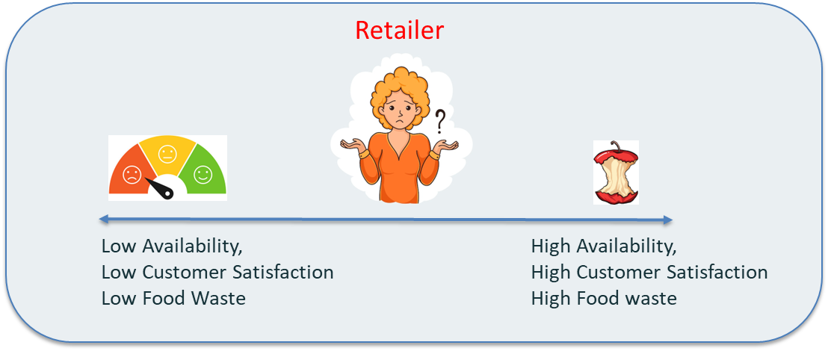
Identify the Problem.
How much to order to optimize inventory management

Slide 10
Structuring the Problem.
Identify the problem
Brainstorm solutions
Assess the feasibility of the solutions
Conclude on strategy
Determine milestones
Set budget, timelines etc

Slide 11
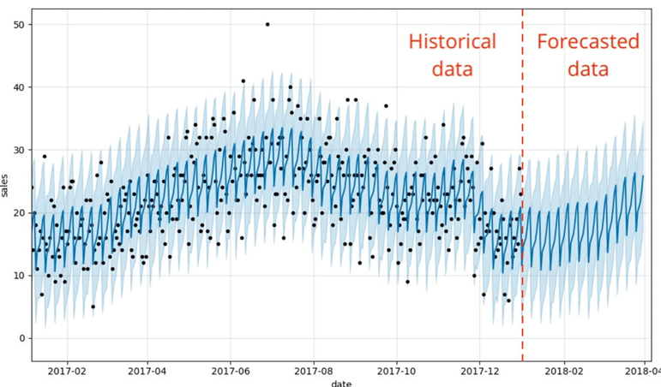
Brainstorm Solutions: Demand Forecasting.
Demand forecasting is the process of predicting future demand using historical data and trends
Our Task:
Predict the demand for meals
Better inventory management
More efficient decision making
No unneeded raw material
Higher profitability

Slide 12


Communicating the Solution
Talk to the Client.
“We want to optimize our inventory management”
“Lets use AI to predict the future demand”. Your reorder policy will be based on the model’s predictions.

Slide 13
Communicating the Solution
Talk to the Client.
“We want to optimize our inventory management”
Sounds good! What do you need from us?
“Lets use AI to predict the future demand”. Your reorder policy will be based on the model’s predictions.
Do you have data? Let me see all data you have. Transactional, reorders, descriptions, everything.

Slide 14
Structuring the Problem.
Identify the problem
Brainstorm solutions
Assess the feasibility of the solutions
Conclude on strategy.
Determine milestones
Set budget, timelines etc

Slide 15
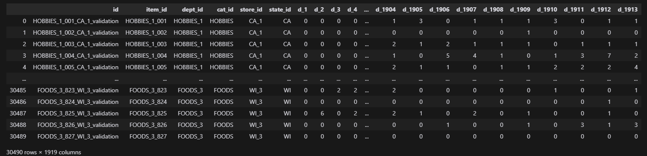
Initial Data
Data can be accessed via: Kaggle

Slide 16
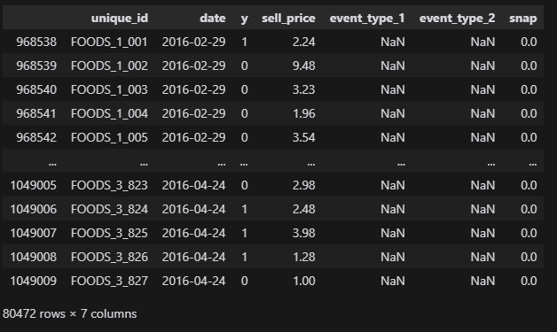
Converted Data
Cleaned data available in Toledo.

Slide 17
Code!

Slide 18
Structuring the Problem.
Identify the problem
Brainstorm solutions
Assess the feasibility of the solutions
Conclude on strategy
Determine milestones
Set budget, timelines etc

Slide 19
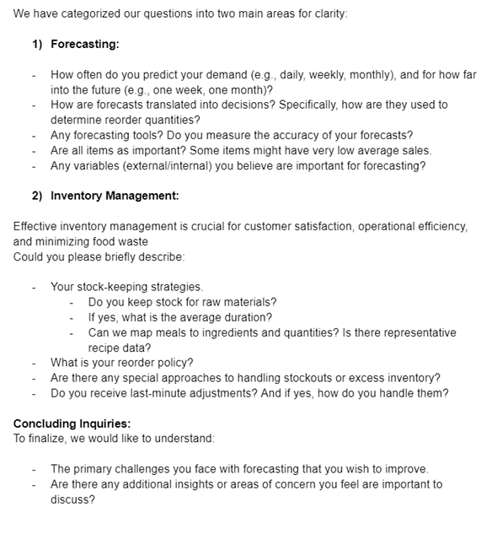
Structure of the report
The aim of the interview:
Deep Data Understanding
Day-to-Day Operations
inventory Management
Primary Challenges
Main Obstacles

Slide 20
Meeting Notes

Slide 21
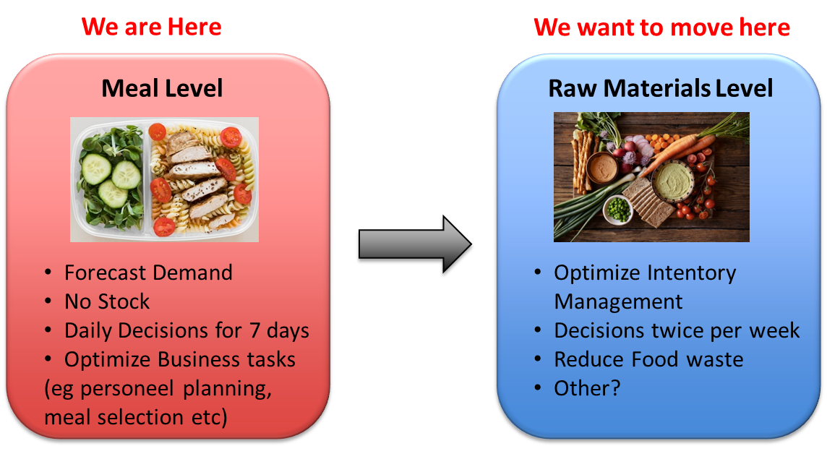
Structure our Methodology:

Slide 22
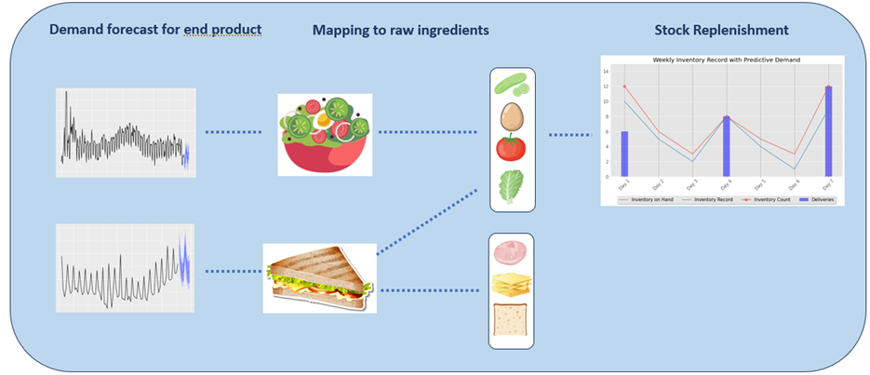
Structure our Methodology
Our strategy:
Forecast daily demand of meals
Decompose meals to raw ingredients
Aggregate daily needed raw ingredients
Optimize Inventory Management

Slide 23
Structuring the Problem.
Identify the problem
Brainstorm solutions
Assess the feasibility of the solutions
Conclude on strategy
Determine milestones
Set budget, timelines etc

Slide 24
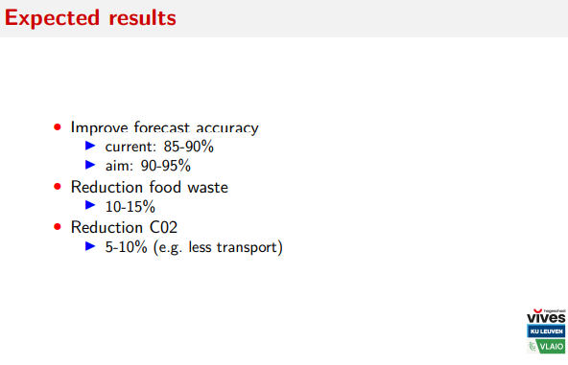
Determine Milestones
Set goals:
Clear & Specific
Achievable
Measurable
Time-bound
Easily communicable

Slide 25
Structuring the Problem.
Identify the problem
Brainstorm solutions
Assess the feasibility of the solutions
Conclude on strategy
Determine milestones
Set budget, timelines etc

Slide 26
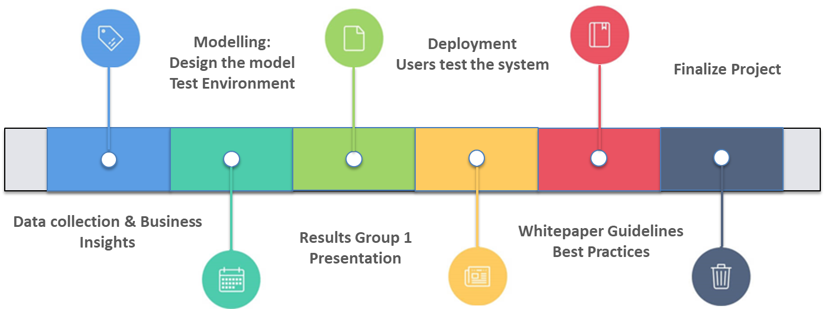
Set Timelines

Slide 27
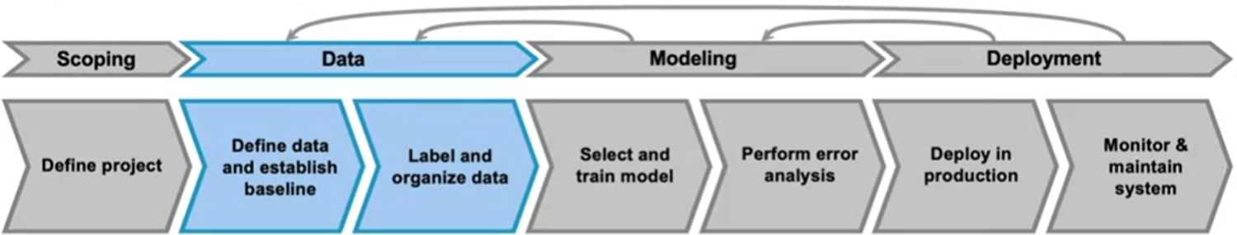
Next Steps:
Collect and organize all of our data.

Slide 28
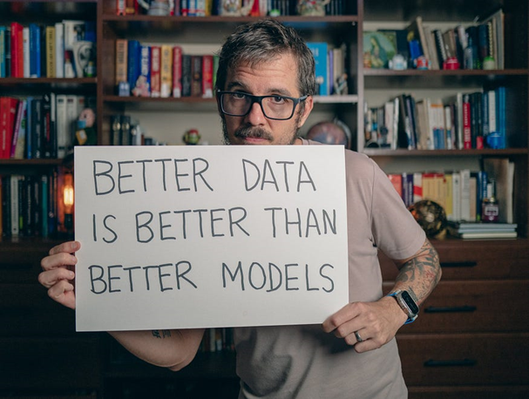
Always Remember:

Slide 29
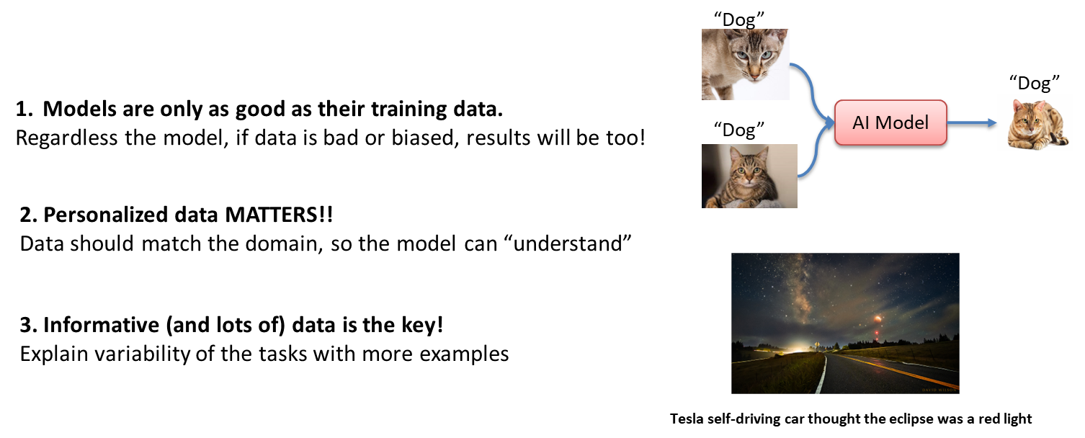
Why?

Slide 30
How to Ensure “Good” Data?
How much data is enough?
Depends.
Example: If your data has a lot of variations, multiple different examples are needed
What is high quality data?
Relevant -> Data should match the domain of the task.
Representitive -> Data should reflect the diversity and the variability of the task.
Reliable -> Data should be accurate, consistent and complete.
Responsible -> Data should be ethical, legal and respectfull of the rights and interests.

Slide 31
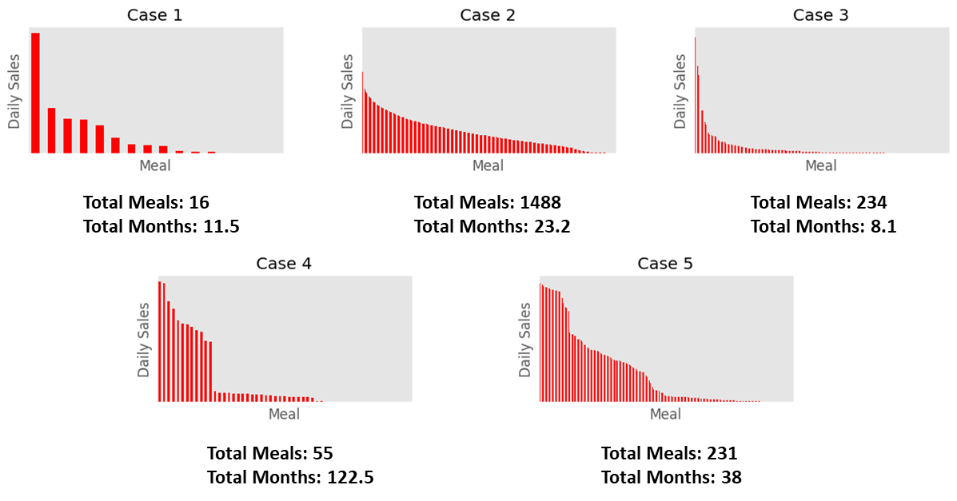
Total sales data:

Slide 32
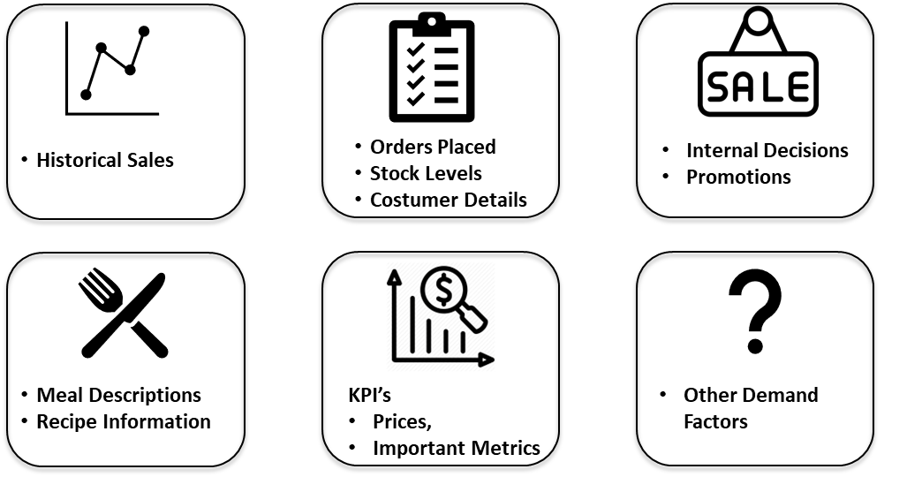
Extra information collected

Slide 33
Understand your Data.
Assuming you have gathered (or not) all the requested data.
Exploratory Data Analysis (EDA)
Understand the data
(patterns, anomalies, limitations)
Inspect data quality
(miss values, outliers)
Guide model selection
(based on data characteristics)
Report to the client
(show deep data understanding)

Slide 34
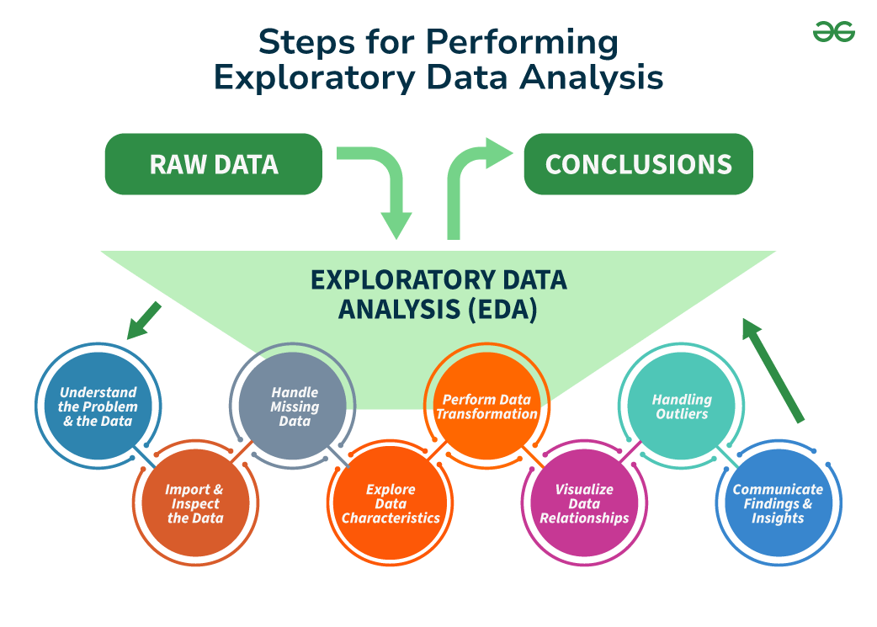
Understand your Data.
Assuming you have gathered (or not) all the requested data.

Slide 35
Code

Slide 36
Communicate your Findings.
Talk to the Client.
“We want to optimize our inventory management”
“Do you have any updates on our project?”
“Lets use AI to predict the future demand”. Your reorder policy will be based on the model’s predictions.
Yes, I have very deep understanding of your data and practises. Check the attached report.

Slide 37
Report with findings of EDA

Slide 38
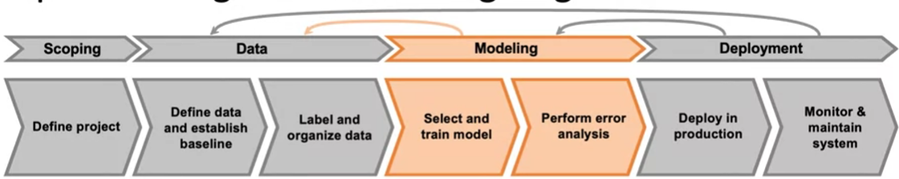
Next Steps: Start Modeling
Establish Baselines
Collect pool of models (aim for models of different complexities)
Increase complexity steadily

Slide 39
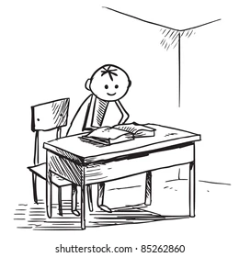
Establish Baselines
How to select a baseline:
Experience
Academic Literature (!)
Web (?)
Note 1: Its very important for your model to outperform:
Current solution used
Simplest benchmark available
Widely applied models
Note 2: If you can't beat them, join them :)

Slide 40
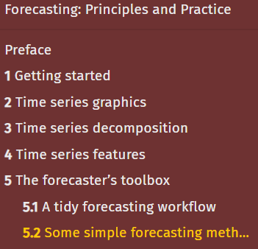
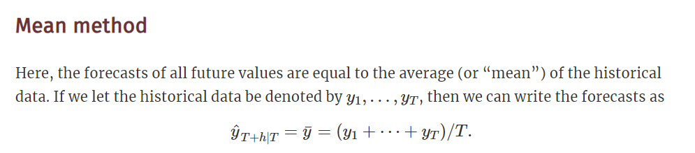
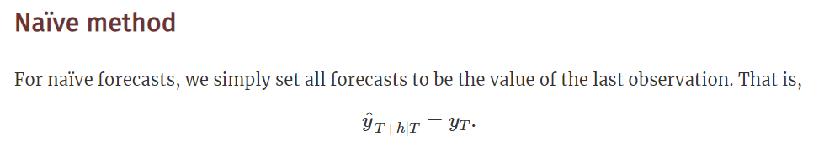
Establish Baselines

Slide 41
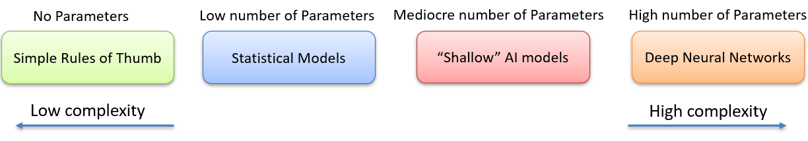
Collect Pool of Models
There is a zoo of models used for forecasting
Rules of Thumb: Baselines
Statistical Models: “Battle-tested” and widely applied
Simple Machine Learning models: Easy to use while taking advantage of ML
Advanced Machine Learning models: Complex to fit but with high potential

Slide 42
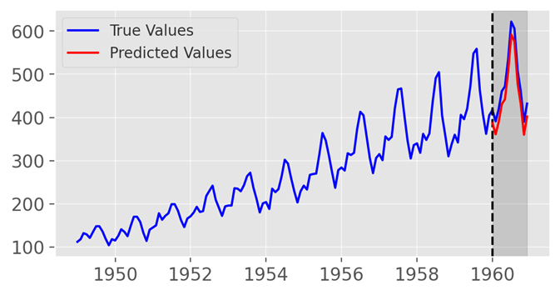
Build an Evaluation Protocol
How to evaluate forecasts?
Split and keep a period as a “test set”
Train a model on the “train set”
Make predictions for the “test set”
Compare predictions with the “true values” using a forecasting metric
For example:

Slide 43
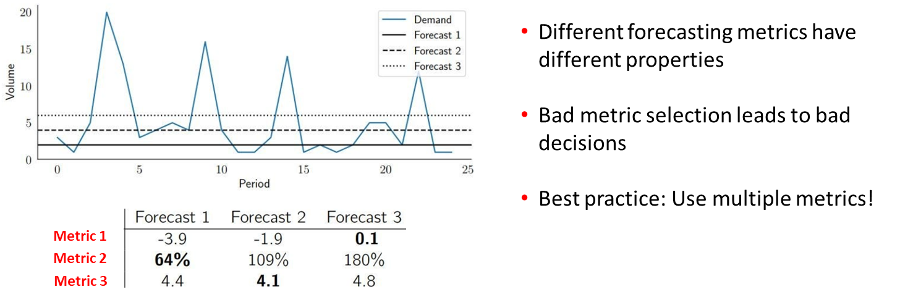
How to Pick a Metric?

Slide 44
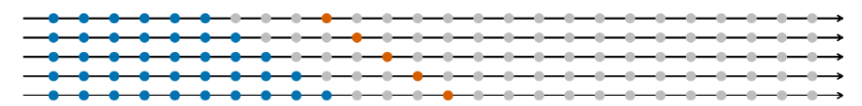
Cross - Validation
More advanced (but much more reliable)
Split train - test set
Make predictions and evaluate
“Roll” the train set by one observation
Make predictions and evaluate
Repeat …
Average all errors

Slide 45
Code
Benchmarks and evaluations

Slide 46
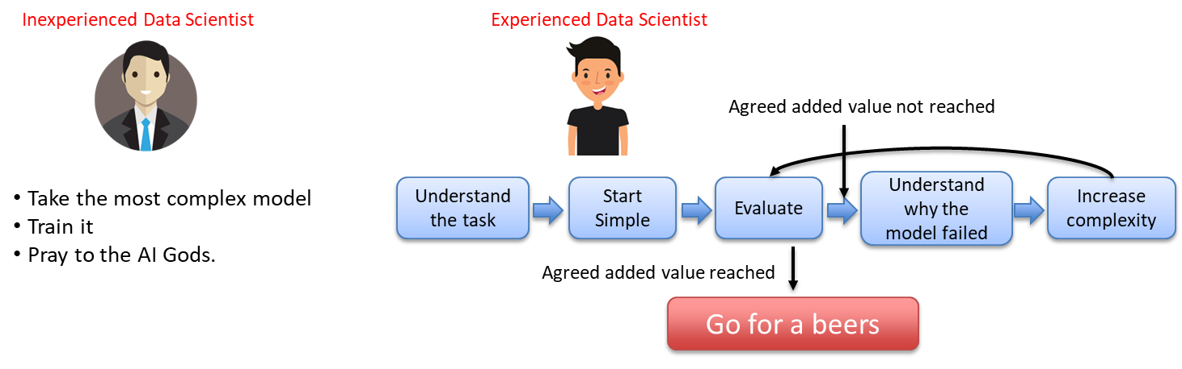
Select the Candidate Model
There is a limit to how much we can predict
There is a limit to how accurately we can predict!
So why use a Bazooka for an Ant?

Slide 47
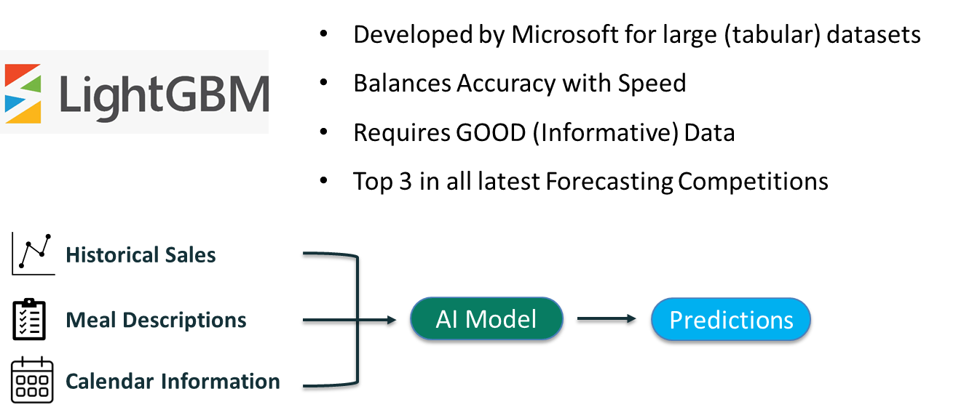
Gradient Boosting Decision Trees

Slide 48
Code
Main Model

Slide 49
Communicate your Findings.
Talk to the Client.
“We want to optimize our inventory management”
“Do you have any updates on our project?”
Can you provide some evidence?
We have successfully reached our agreed goals

Slide 50
Communicate results
Client has no technical background
Effectively communicate milestones
Try to reduce technical details

Slide 51
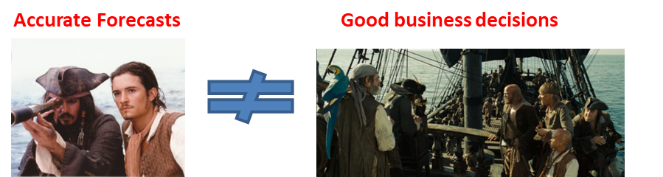
Communicate results
Client has no technical background
Effectively communicate milestones
Try to reduce technical details
Business people care for hands-on results

Slide 52
Forecast report

Slide 53
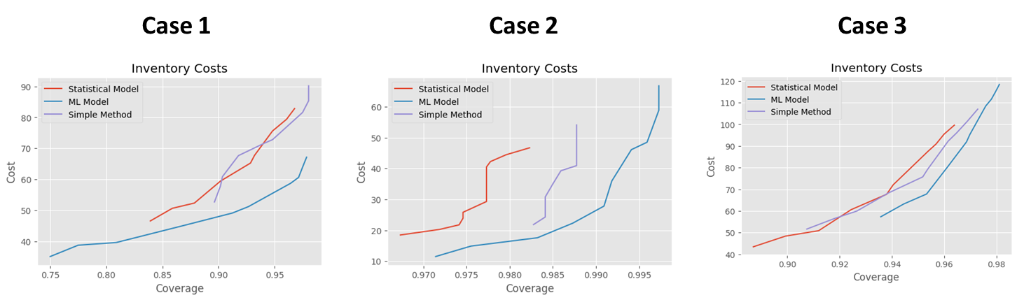
Communicate Results

Slide 54
Communicate your Findings.
Talk to the Client.
“We want to optimize our inventory management”
“Do you have any updates on our project?”
Can you provide some evidence?
They are amazing. How can we access the model?
We have successfully reached our agreed goals
What do you think of these results?

Slide 55
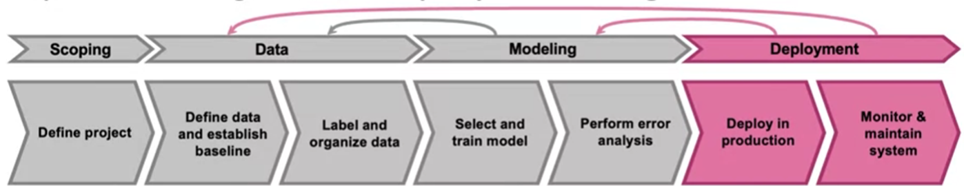
Deploying the Model

Slide 56
Before Deploying
Production Level Code Principles:
Structured project repositories
Scalable and reproducible code
Clean code principles
Logging and Error Handling
Documentation and Commenting
Code Formatting and Styling
Writing good tests
Pipelines in ML projects

Slide 57
Code
File Examples

